Slide 1
🚀 Deploying Machine Learning Models with FastAPI AI Engineering Internship Assignment 👨‍💻 Nikhil S Doshikar 📊 Data Science Intern 🏢 [Company Name - WiseAnalytics ] 💼 End-to-End ML Pipeline: Training → API → Dashboard

Slide 2
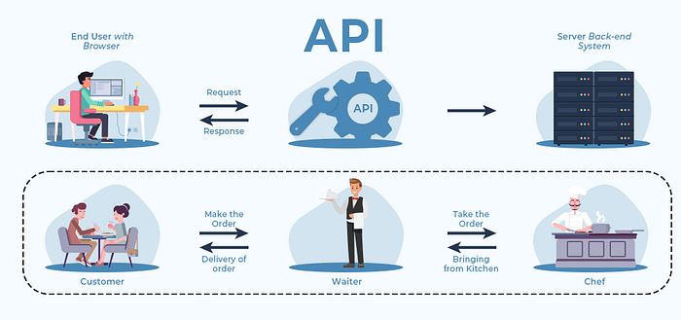
What is an API?
API = Application Programming Interface
Set of rules and protocols for communication between software components
Enables different applications or modules to exchange data safely and efficiently
Analogy :
“Like a waiter in a restaurant—the waiter (API) takes the order from the customer (frontend) and gives it to the kitchen (backend), bringing the prepared meal (data) back.”

Slide 3
Why Are APIs Important?
Early applications were monolithic: frontend, backend, and database tightly coupled
Hard to update or scale, limited flexibility for growing needs
APIs allow decoupling—enabling websites, mobile apps, and other clients to use the same backend service seamlessly
Promotes modular, scalable, and maintainable software design

Slide 4
Why FastAPI is a Game Changer
What is FastAPI?
A modern, high-performance Python framework for building robust and scalable web APIs.
Lightning-fast thanks to asynchronous programming (async/await) for handling many concurrent requests efficiently.
Widely used in industry to expose ML, Deep Learning, and Generative AI models as inference endpoints.
🧠 Real-World Analogy
"FastAPI is like a smart restaurant where the waiter keeps moving and taking new orders while the kitchen is busy preparing previous ones — maximizing efficiency and responsiveness

Slide 5
Key Components:
👤 Client
↓
⚡ FastAPI 🐍
↓
🔁 Starlette (Async Processing)
🔍 Pydantic (Input Validation)
↓
🧠 ML Model (Prediction)
↓
📦 JSON Response (Universal Format)
Starlette: Handles HTTP requests/responses asynchronously with efficient concurrency management.
Pydantic: Validates and parses incoming data automatically, reducing bugs and manual coding.

Slide 6
How FastAPI Works
Philosophy & Design:
Created to overcome performance and boilerplate issues in older frameworks like Flask.
Emphasizes APIs that are both fast in execution and fast to develop.
In synchronous APIs, slow tasks block other requests, causing delay.
FastAPI uses async/await so the server handles other requests while waiting, improving responsiveness.
Why FastAPI?
Fast to run: Uses ASGI protocol with Uvicorn server, enabling non-blocking, parallel request handling.
Fast to code: Minimal, clean, and readable code; automatic input validation and interactive API docs.
Highly compatible: Seamless integration with ML libraries like scikit-learn, TensorFlow, and databases.
⚡ Fast to Run
└── ASGI + Uvicorn = High performance
🔁 Handles Multiple Requests
└── async/await = Non-blocking server
🐍 Fast to Code
└── Clean syntax + auto input validation
🔍 Built-In Docs
└── `/docs` for testing live APIs
🧠 ML-Ready
└── Integrates easily with TensorFlow, scikit-learn, etc.

Slide 7
FastAPI in the ML World
FastAPI: A Python framework built for quickly creating robust, scalable APIs.
Lightning-fast & simple: Excellent for deploying ML, deep learning, or generative AI models.
Asynchronous operations:
Lets FastAPI manage many requests concurrently, even when your app waits on slow models or databases.
Improves speed and scalability.
Industry standard:
FastAPI powers real-world AI products by exposing models as secure web services (“inference endpoints”).

Slide 8
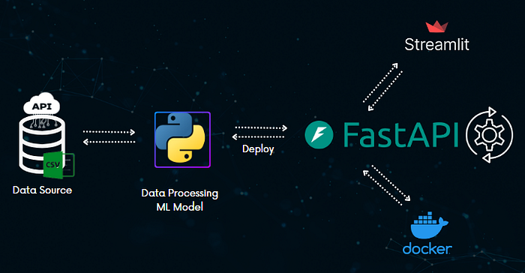
Real Machine Learning Use Case
When you build an ML or AI model, customers need access through a website or app.
Direct database or backend access is risky and impractical—instead, you expose the model’s power via an API.
APIs let your product securely offer predictions or intelligent features to users, abstracting away the complexity.
Modern companies use FastAPI for this:
Fast and asynchronous: Handles many user requests at once.
Widely adopted: Standard for deploying AI/ML models as live, production APIs.

